Slide 1
Deep6mAPred: A CNN and Bi-LSTM-based deep learning method for predicting DNA N6-methyladenosine sites across plant species
Reporter: Ping-Hsueh Ho

Slide 2
Outline
Background and Motivation
Related Work
Materials
Designed Experiment
Proposed Methods
Results and Comparisons
Analysis and Discussion
Conclusion

Slide 3
Background and Motivation
DNA methylation alters activities of DNA segments without changing the sequence, which thus yields a wide variety of roles in the cellular processes across organisms or tissues
DNA methylation is widely distributed both in prokaryote and in eukaryote, but the proportion of methylated residues differs greatly with species
DNA methylation → essential for normal development
DNA methylation is increasingly attracting attentions from biologists
Notes:
舉例第二點：5mc佔多頭絨泡菌胞嘧啶總量的不少於8%。 高達 75% 的 CpG 二核苷酸在哺乳動物的體細胞中被甲基化，14% 的胞嘧啶在擬南芥中被甲基化，在大腸桿菌中為 2.3%，在果蠅中為 0.03%，在盤基網柄菌中為 0.006%
舉例第三點：DNA 甲基化與許多細胞過程有關，如基因組印記、X 染色體失活，也暗示在包括癌症在內的許多疾病中，並作為一個準確的表觀遺傳時鐘來估計組織的年齡以及細胞類型 人類或哺乳動物

Slide 4
Background and Motivation
What is 6mA?
Why is it important?
Notes:
6mA是指在DNA甲基轉移酶的作用下，甲基附著在腺嘌呤的第6個氮原子上的生物過程
6mA 是一種非規範 DNA 修飾，因為它可能發生在其他核苷酸分子中，包括 mRNA、tRNA、rRNA、小核 RNA (snRNA) 以及長鏈非編碼 RNA
大量證據表明，DNA 6mA 將在許多關鍵生物過程中發揮重要作用
DNA 6mA 參與了原核生物和一些真核生物中基因表達的調節，並負責 DNA 修復和 DNA 複製
6mA 在原核生物中區分入侵的外源 DNA 與宿主 DNA，與人類基因組中包括腫瘤在內的許多疾病密切相關，並參與三陰性乳腺癌耐藥性的調節

Slide 5
Related Work
Even Luo et al.[41] - proposed the DNA 6mA as a new epigenetic mark in eukaryotes
2 major ways to detect DNA 6mA sites:
Wet experiments
mass spectrometry / methylation-specific polymerase chain reaction / single-molecule real-time sequencing
Times consuming / expensive / labor-intensive
[41] G.Z. Luo, M.A. Blanco, E.L. Greer, C. He, Y. Shi, DNA N(6)-methyladenine: a new epigenetic mark in eukaryotes? Nat. Rev. Mol. Cell Biol. 16 (12) (2015) 705–710, https://doi.org/10.1038/nrm4076.

Slide 6
Related Work
Dry experiments - computational methods
learning a classifier → feature-based and the deep learning-based methods
Pian et al.[45] - employed transition probability between adjacent nucleotides to construct a Markov model to identify 6mA site
Chen et al.[47] – SVM based method for rice 6mA prediction
[45] C. Pian, G. Zhang, F. Li, X. Fan, MM-6mAPred: identifying DNA N6- methyladenine sites based on Markov model, Bioinformatics 36 (2) (2020) 388–392, https://doi.org/10.1093/bioinformatics/btz556.
[47] W. Chen, H. Lv, F. Nie, H. Lin, i6mA-Pred: identifying DNA N6-methyladenine sites in the rice genome, Bioinformatics 35 (16) (2019) 2796–2800, https://doi.org/10.1093/bioinformatics/btz015.
Notes:
是指計算方法，它通過從已知的 6mA 數據（通常標記為正）和非 6mA 數據（標記為負）中學習分類器來自動註釋 6mA 位點
利用相鄰核苷酸之間的轉移概率構建馬爾可夫模型來識別 6mA 位點
基於SVM的水稻6mA預測方法，僅以核苷酸頻率和核苷酸化學性質為代表

Slide 7
Related Work
The i6mA-DNCP[51]
improve the representation with optimized dinucleotide-based features
iDNA6mA-Rice[1] –
multiple encoding schemes as representations / random forest
6mA-RicePred[53] –
fused multiple features including Markov feature for rice 6mA prediction
[51] L. Kong, L. Zhang, i6mA-DNCP: computational identification of DNA N6- methyladenine sites in the rice genome using optimized dinucleotide-based features, Genes 10 (10) (2019) 828, https://doi.org/10.3390/genes10100828.
[1] H. Lv, F.Y. Dao, Z.X. Guan, D. Zhang, J.X. Tan, Y. Zhang, W. Chen, H. Lin, iDNA6mA-Rice: a computational tool for detecting N6-methyladenine sites in rice, Front. Genet. 10 (2019) 793, https://doi.org/10.3389/fgene.2019.00793.
[53] Q. Huang, J. Zhang, L. Wei, F. Guo, Q. Zou, 6mA-RicePred: a method for identifying DNA N6-methyladenine sites in the rice genome based on feature fusion, Front. Plant Sci. 11 (2020) 4, https://doi.org/10.3389/fpls.2020.00004.
Notes:
i6mA-DNCP [51] 通過優化的基於二核苷酸的特徵改進了表示，從而提升了 i6mA-Pred 的性能。
作者說有些特徵可以貢獻很多在偵測6mA為點上，而有些特徵就沒那麼多，理想上只要把全部的特徵都組合起來，應該會得到不錯的成果，但是實際上這並不能保證會提高performance，相反的會增加運算的負擔(他說的沒錯)
iDNA6mA-Rice利用多種編碼方案（PseKNC、mono-nucleotide binary encoding和natural vector）作為representation，並使用隨機森林作為學習算法
6mA-RicePred 融合了多種特徵，包括用於水稻 6mA 預測的馬爾可夫特徵

Slide 8
Related Work
csDMA[54] – three representations and explore the best one
6mA-Finder[55] – seven sequence-based coding schemes
…
But, the feature-based method had difficulty in achieving the best performance in practice because the combination was infinite.
[54] Z. Liu, W. Dong, W. Jiang, Z. He, csDMA: an improved bioinformatics tool for identifying DNA 6 mA modifications via Chou’s 5-step rule, Sci. Rep. 9 (1) (2019) 1–9, https://doi.org/10.1038/s41598-019-49430-4.
[55] H. Xu, R. Hu, P. Jia, Z. Zhao, 6mA-Finder: a novel online tool for predicting DNA N6-methyladenine sites in genomes, Bioinformatics 36 (10) (2020) 3257–3259, https://doi.org/10.1093/bioinformatics/btaa113.
Notes:
csDMA利用三種representations探索了不同演算法對6mA預測的性能，最終選擇了實驗中表現最好的算法來構建預測器
6mA-Finder 結合了七種基於序列的編碼方案，如累積核苷酸頻率(accumulated nucleotide frequency)、K 間隔核酸對的組成(the composition of K-spaced nucleic acid pairs)、三種理化特徵(physicochemical features)和七種常規學習算法(conventional learning algorithms)

Slide 9
Related Work
iIM-CNN - employed CNN
iDNA6mA - deep learning-based method / CNN
Huang et al. [72] - LSTM-based method called 6mA-Pred
Le et al. [73] - employed transformer-based BERT
DNA6mA-MINT [74] - stacked CNN and LSTM simply
[72] Q. Huang, W. Zhou, F. Guo, L. Xu, L. Zhang, 6mA-Pred: identifying DNA N6- methyladenine sites based on deep learning, PeerJ 9 (2021), e10813, https://doi.org/10.7717/peerj.10813.
[73] N.Q.K. Le, Q.T. Ho, Deep transformers and convolutional neural network in identifying DNA N6-methyladenine sites in cross-species genomes, Methods (2021), https://doi.org/10.1016/j.ymeth.2021.12.004.
[74] M.U. Rehman, K.T. Chong, DNA6mA-MINT: DNA-6mA Modification Identification Neural Tool, Genes 11 (8) (2020) 898, https://doi.org/10.3390/genes11080898.
Notes:
CNN 沒有學習隱藏在角色中的關係。 僅靠 CNN 學習到的特徵不足以表示 6mA 序列 → LSTM
Stack的方式並不是一個好的選擇，因為它不利於積累分別由 CNN 和 LSTM 學習到的表示。 作者改進了結合 CNN 和 LSTM 的方法，並提出了一種改進的計算方法，稱為 Deep6mAPred，用於預測不同的 6mA 位點

Slide 10
Problem Statement

Slide 11
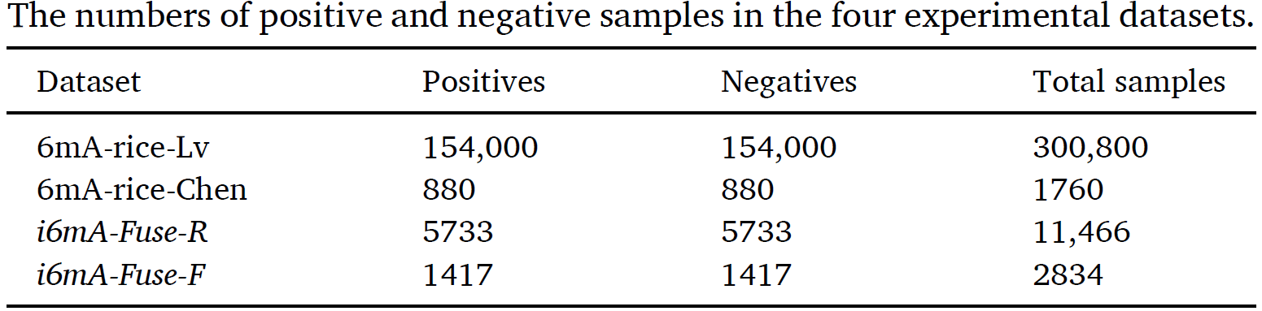
Materials
4 DNA 6mA datasets + 3 diverse plants
Notes:
6mA-rice-lv 由 zhou 首創於水稻基因組
6mA-ricechen，同樣來自水稻基因組，也比較多人用
為了測試不同物種6mA sites，作者另外使用i6mA-Fuse-F 和 i6mA-Fuse-Rdataset, 這兩個都是i6mA-Fuse子資料集
i6mA-Fuse-R 來自薔薇 / i6mA-Fuse-F 來自 Fragaria vesca (野莓)

Slide 12
Hypothesis

Slide 13
Designed Experiment
Training Dataset: 6mA-rice-Lv[1]
Testing Dataset: 6mA-rice-chen / i6mA-Fuse-R / i6mA-Fuse-V
5-Fold Cross-Validation
[1] H. Lv, F.Y. Dao, Z.X. Guan, D. Zhang, J.X. Tan, Y. Zhang, W. Chen, H. Lin, iDNA6mA-Rice: a computational tool for detecting N6-methyladenine sites in rice, Front. Genet. 10 (2019) 793, https://doi.org/10.3389/fgene.2019.00793.

Slide 14
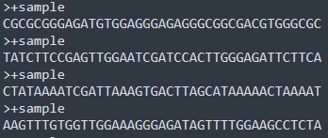
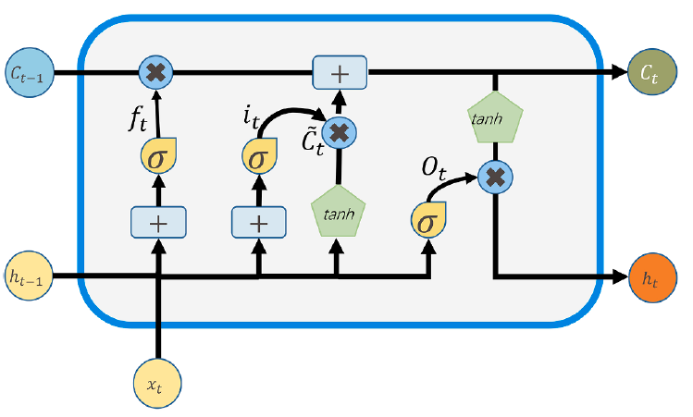
Proposed Method – Whole shcmatic
A->1000
C->0100
G->0010
T->0001
Notes:
CNN → LSTM → Bi-LSTM → Feed-forward attentions → Loss fn(BCE) →
單純RNN會有梯度消失和爆炸的問題，所以要用LSTM來解
Attention mechanism有很多種：包含self-attention / feed-forward attention / external attention / double attentions
本論文章是使用feed-forward attention，因為feed-forward attention最初是為了解決 LSTM 中的長期依賴問題。 其核心是通過以下公式計算每個時間步隱藏狀態的權重

Slide 15
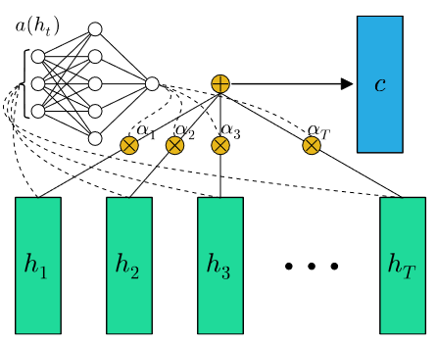
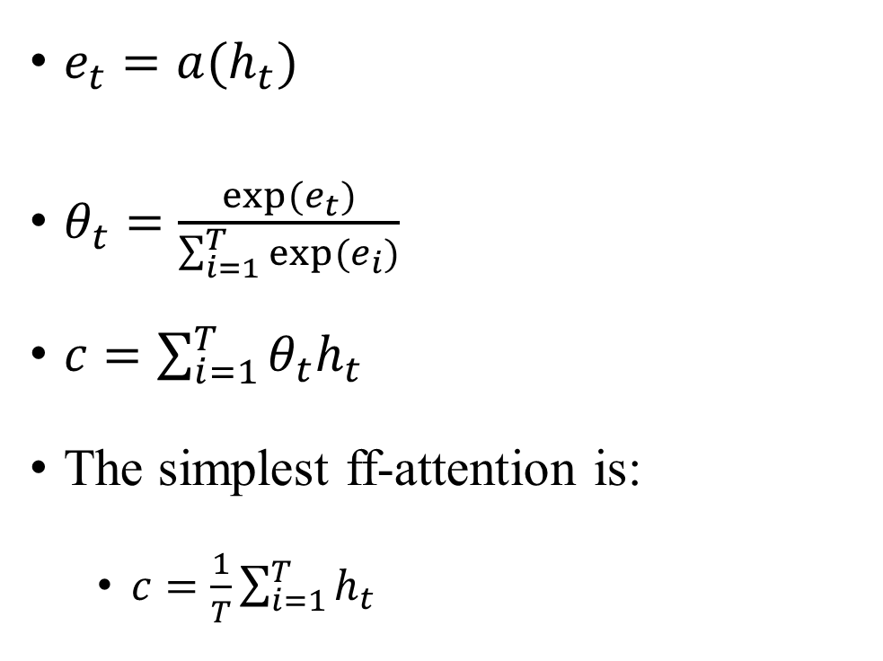
Proposed Method – FF attention[98]
$e_{t}=a(h_{t})$
$θ_{t}=\frac{exp⁡(e_{t})}{\sum_{i=1}^{T}{exp⁡(e_{i})}}$
$c=\sum_{i=1}^{T}{θ_{t}h_{t}}$
The simplest ff-attention is:
$c=\frac{1}{T}\sum_{i=1}^{T}{h_{t}}$
Notes:
$h_{t}$是在time等於t時的hidden state
$θ_{t}$就是一個softmax，用在normalized weight

Slide 16
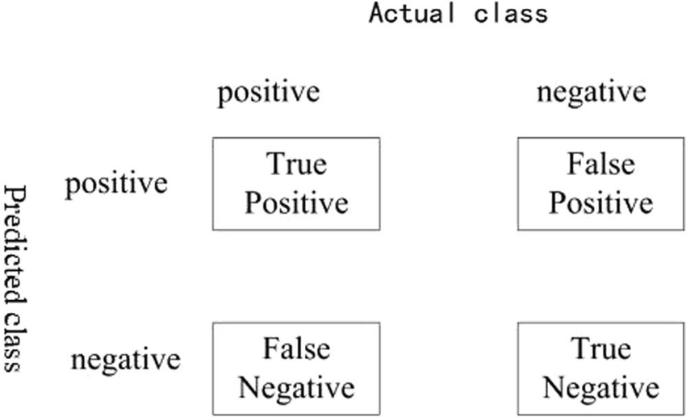

Results and Comparisons – Metrics
$S_{n}=\frac{T_{P}}{T_{P}+F_{N}}$
$S_{P}=\frac{T_{N}}{T_{N}+F_{P}}$
$ACC=\frac{T_{P}+T_{N}}{T_{P}+T_{N}+F_{N}+F_{P}}$
$MCC=\frac{T_{P}∗T_{N}−F_{N}∗F_{P}}{\sqrt{(T_{P}+F_{N})(T_{P}+F_{P})(T_{N}+F_{P})(T_{N}+F_{N})}}$
Receiver operating characteristic (ROC) curve$\left\{\begin{aligned}x−axis:False Positive Rate \\ y−axis:True Positive Rate\end{aligned}\right.$
Precision-recall (PR) curve$\left\{\begin{aligned}Pre=\frac{T_{P}}{T_{P}+F_{P}} \\ Recall:S_{n}\end{aligned}\right.$

Slide 17
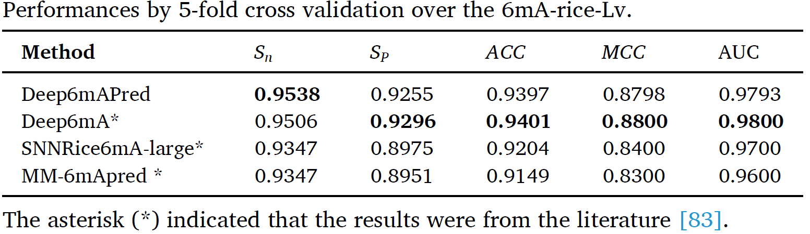
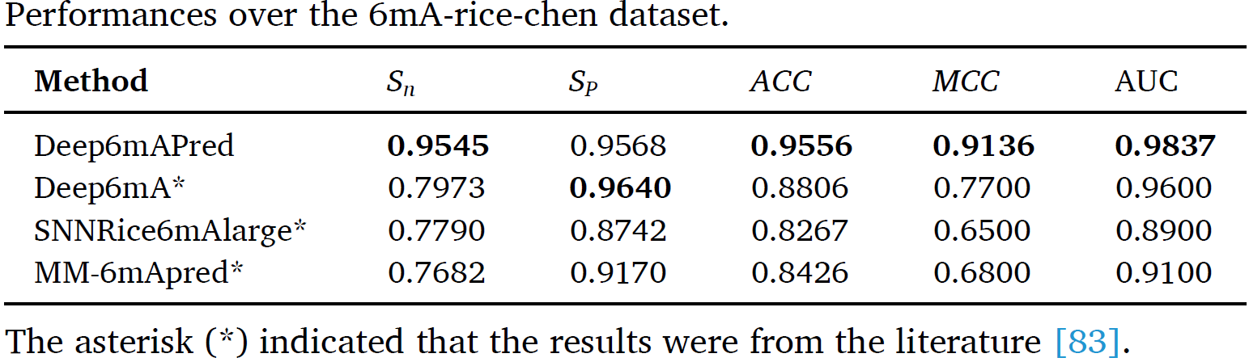
Results and Comparisons – 6mA-rice-Lv & 6mA-rice-chen
Deep6mA [83]
SNNRice6mA-large [79]
Deep6mAPred [45]
[83] Z. Li, H. Jiang, L. Kong, Y. Chen, K. Lang, X. Fan, L. Zhang, C. Pian, Deep6mA: A deep learning framework for exploring similar patterns in DNA N6- methyladenine sites across different species, PLoS Comput. Biol. 17 (2) (2021), e1008767, https://doi.org/10.1371/journal.pcbi.1008767.
[79] H. Yu, Z. Dai, SNNRice6mA: a deep learning method for predicting DNA N6- methyladenine sites in rice genome, Front. Genet. 10 (2019) 1071, https://doi.org/10.3389/fgene.2019.01071.
[45] C. Pian, G. Zhang, F. Li, X. Fan, MM-6mAPred: identifying DNA N6- methyladenine sites based on Markov model, Bioinformatics 36 (2) (2020) 388–392, https://doi.org/10.1093/bioinformatics/btz556.
Notes:
針對6mArice-Lv做5-fold cross validation，原文說：比三種state-of-the-art的方法達到了更好的 Sn，並且與 Deep6mA 相比實現了具有競爭力的 SP、ACC 和 MCC，完全優於 SNNRice6mA-large 和 MM-6mApred*
Deep6mAPred比Deep6mA增加了Sn 0.1572，ACC增加了0.0750，MCC增加了0.1436，ROC曲線的AUC增加了0.0237，完全優於其他兩種方法。 Deep6mAPred 的 SP 略低於 Deep6mA，但遠高於另外兩種方法

Slide 18
Results and Comparisons – 6mA-Fuse-R & 6mA-Fuse-F

Slide 19
Results and Comparisons – 6mA-Fuse-R & 6mA-Fuse-F
Model | AUC of ROC Curves |  | AUC of PR Curves
 | 6mA-Fuse-F | 6mA-Fuse-R | 6mA-Fuse-F | 6mA-Fuse-R
Deep6mAPred | 0.9830 | 0.9635 | 0.9830 | 0.9628
Deep6mA* | 0.9820 | N/A | 0.9820 | N/A
SNNRice6mA-large* | 0.9640 |  | 0.9630
MM-6mApred* | 0.9600 |  | 0.9590
Notes:
Deep6mAPred比Deep6mA增加了Sn 0.1572，ACC增加了0.0750，MCC增加了0.1436，ROC曲線的AUC增加了0.0237，完全優於其他 兩種方法（SNNRice6mA-large 和 MM-6mAPred）。 Deep6mAPred 的 SP 略低於 Deep6mA，但遠高於 SNNRice6mA-large 和 MM-6mAPred。

Slide 20
Results and Comparisons – W/ or W/O Attention
Notes:
顯然，加入attention提升了預測性能

Slide 21
Results and Comparisons – Tune Epoch
Notes:
(A)-(C) is ROC curves for F.vesca, R. chinensis, and 6mA-rice-Chen respectively
(D)-(F) is PR curves for F.vesca, R. chinensis, and 6mA-rice-Chen
迭代次數對 Deep6mAPred 的影響。我們分別使用 50、100、150、200、250 和 300 個 epoch 來訓練 Deep6mApred，並使用三個獨立的數據集對其進行檢驗
不同時期的 ROC 曲線和 PR 曲線幾乎完全相同。 AUC 的標準差小於 0.0030，這意味著 Deep6mAPred 對迭代數具有robustness

Slide 22
Analysis and Discussion
Previous methods stacked CNN and LSTM in a series-connection manner. The CNN is good at characterizing local properties, while the LSTM does well in long-term dependency of words in sequences. Stacking them in a series-connection manner would lose their respective merits.
Instead, the Deep6mAPred uses the CNN and the LSTM in parallel, which makes full use of their advantages, but avoid their limitations.
In addition, the Deep6mAPred uses the attention mechanism.
Notes:
這些方法以串聯方式堆疊 CNN 和 LSTM。 CNN 擅長表徵局部屬性，而 LSTM 擅長描述序列中單詞的長期依賴性。以串聯的方式堆疊它們會失去各自的優點。相反，Deep6mAPred 並行使用 CNN 和 LSTM，充分利用了它們的優勢，但避免了它們的局限性。這可能是 Deep6mAPred 優於 Deep6mA 的原因

Slide 23
Conclusion
The 6mA is a key mechanism of regulation in the cellular processes.
We presented a CNN and LSTM-based method (Deep6mAPred) with paralleling manner
Attention mechanism
User-friendly webserver to automatically detect 6mA sites
Deep6mAPred can also detect other plants
Notes:
6mA 是細胞過程中的關鍵調節機制。 由於對其知識的限制，精確檢測 6mA 站點仍然是一項具有挑戰性的任務。 我們提出了一種基於 CNN 和 LSTM 的方法 (Deep6mAPred) 來解決這個問題。 Deep6mAPred將CNN和LSTM並行堆疊，充分利用了CNN和LSTM的長處。 注意機制改進了 6mA 序列的表示。 我們還開發了一個用戶友好的網絡服務器來自動檢測 6mA 站點。 Deep6mAPred 是一種有競爭力的方法或工具，不僅可以預測水稻中的 6mA，也可以預測其他植物中的 6mA。

Slide 24
Q&A
Thank you

